Slide 1
GRAPHIES
Community Detection Based On Markov
Edge Similarity
Diya Patel
AU2120193
Samya Shah
AU2140232

Slide 2
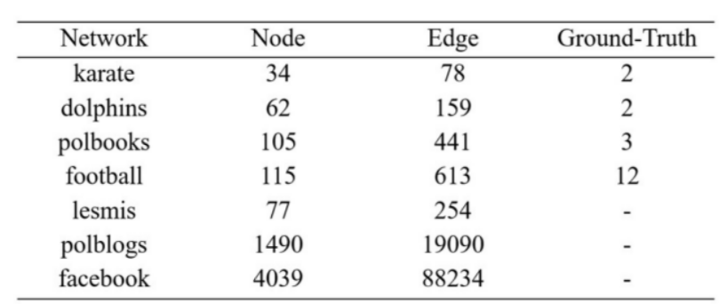
PROBLEM STATEMENT
Community Detection Based on Markov Edge Similarity
DATASETS

Slide 3
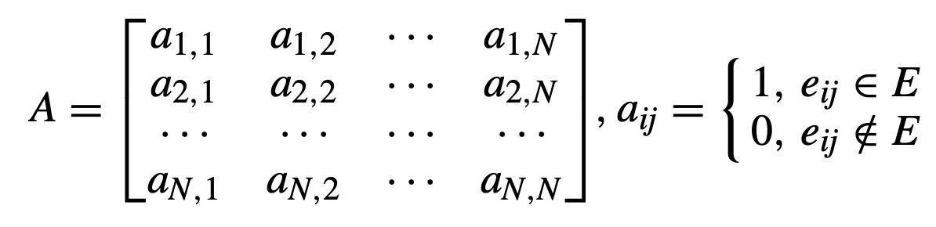
BACKGROUND
G = (V , E)
V = {v1,v2,...,vN} are nodes
N represents the number of nodes
𝜞(vi) indicates the set of neighbours of node i
|E| number of edges between nodes in network
|𝜞(vi)| number of neighbours of node in the network
adjacency matrix A

Slide 4
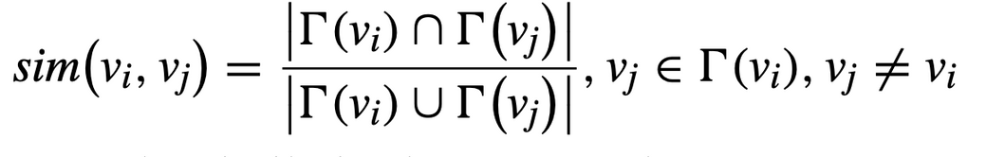
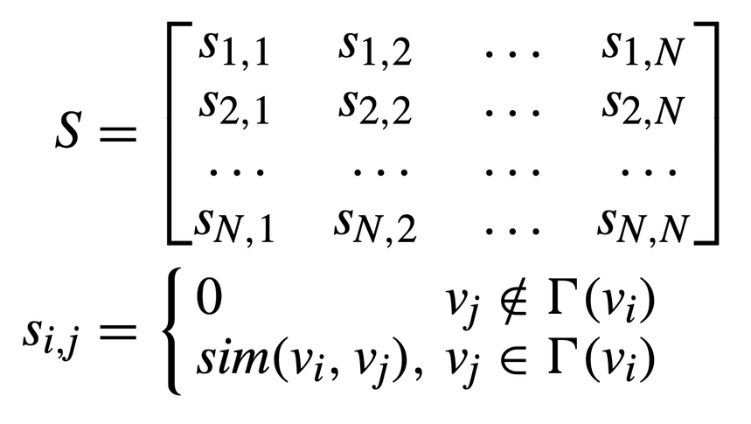
BACKGROUND
Jaccard local similarity index
State transition matrix of the network

Slide 5
BACKGROUND
Community Detection Based on Markov Similarity Enhancement
A method for community detection using a Markov chain.
Their approach involves
Enhancing Markov similarity iteratively in the initial network, resulting in a steady-state Markov similarity enhancement matrix.
They use this similarity matrix to identify the most similar nodes to each node, helping establish an initial community structure.
They merge smaller communities with closely connected larger communities to get the final community structure.

Slide 6
OUR APPROACH
Input: Take in a network (G) consisting of nodes (V) and edges (E), a similarity matrix (S), and two thresholds (λ and τ).
Step 1: Get Adjacency Matrix: Create an adjacency matrix to represent the network.
Step 2: Get Jaccard Coefficients: Calculate Jaccard coefficients for all pairs of nodes to measure their similarity.
Step 3: Normalize Coefficients: Normalize the Jaccard coefficients to make them comparable.
Step 4: Matrix Operation: Perform a matrix operation using the normalized coefficients, the adjacency matrix, and the average node degree.
Step 5: Form Initial Communities: Begin with each node as its own community. Update the result matrix based on a threshold (τ) until no further merges can be made or all communities meet another threshold (λ).
Step 6: Merge Small Communities: Classify communities as small or large based on a threshold (λ). Merge small communities with the best matching large communities until no unassigned nodes remain.
Output: Provide the final set of communities formed after the merging process.

Slide 7
OUR APPROACH
Step-5
Function form_initial_communities:
Input: A matrix of similarity scores between all pairs of nodes, a threshold for community size, and a threshold for similarity
1. Start with each node in its own community.
2. Update the similarity matrix so that only similarities above the similarity threshold are considered.
3. Repeat the following until no more communities can be merged:
a. Find the pair of communities with the highest average similarity.
b. If their average similarity is above the similarity threshold, merge them into a single community.
c. If all communities now have a size above the community size threshold,or if similarity threshold between the communities is l less then similarity threshold, stop the process.
4. Return the list of formed communities.
Note: This process initially treats each node as its own community and then progressively merges communities based on their similarity, aiming to form larger, more cohesive groups.

Slide 8
OUR APPROACH
Step-6
Function merge_small_communities:
Input: The graph G, a list of initial communities, and a threshold for what constitutes a 'small' community
1. Separate the communities into 'small' and 'large' based on the given threshold.
2. For each small community:
a. Try to find a large community that has the highest total similarity with it.
b. If such a large community is found, merge the small community into it.
c. If no such large community is found, keep the nodes of the small community as unassigned.
3. For each unassigned node:
a. Try to find a large community that has the highest total similarity with it.
b. If found, add the node to that large community.
4. Combine all the large communities (now possibly merged with small communities) and any remaining small communities that meet the size threshold.
5. Return the final list of merged communities.
Note: This process aims to integrate smaller, less connected groups into larger, more cohesive communities, enhancing the overall structure and connectivity of the network. In our algorithm we have kept the threshold 𝞴=2

Slide 9
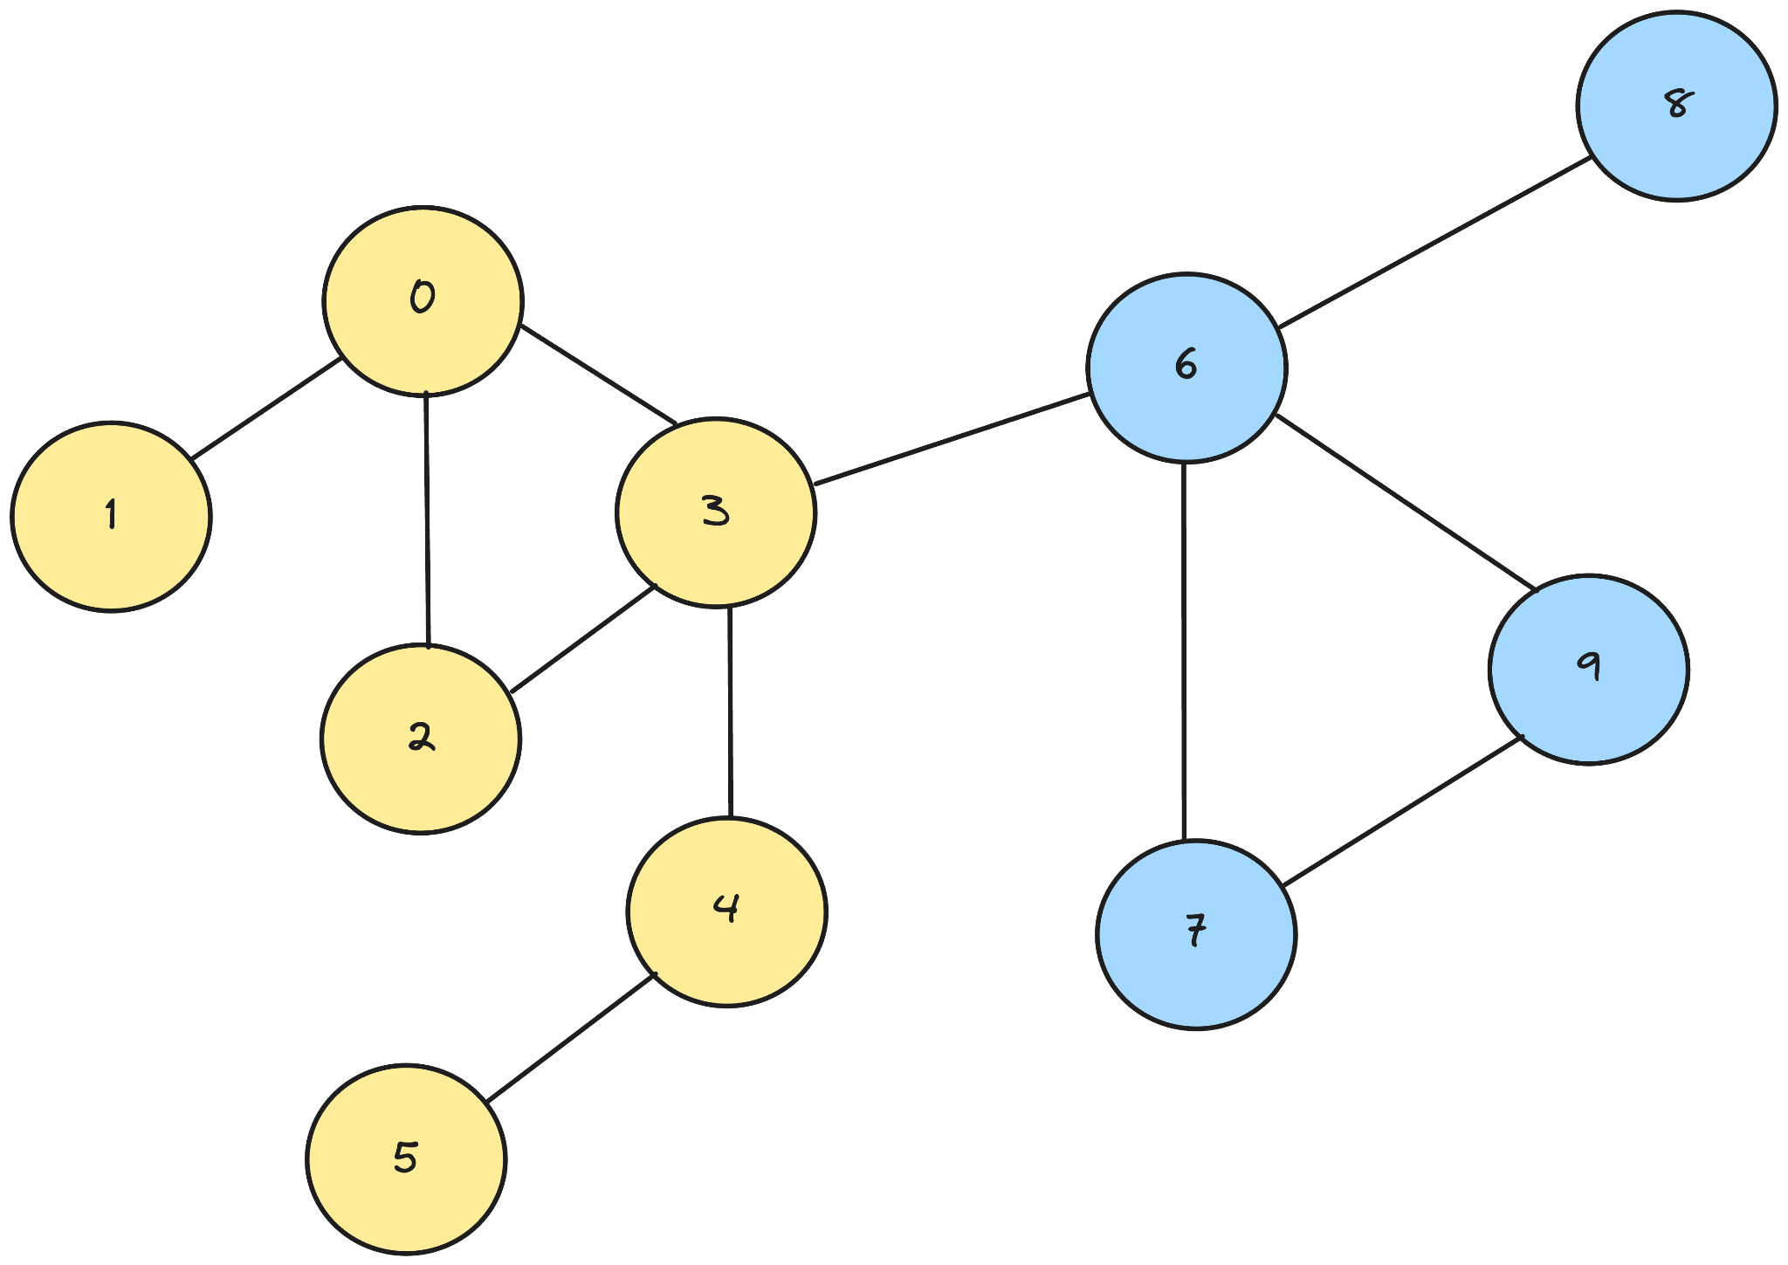
EXAMPLE

Slide 10
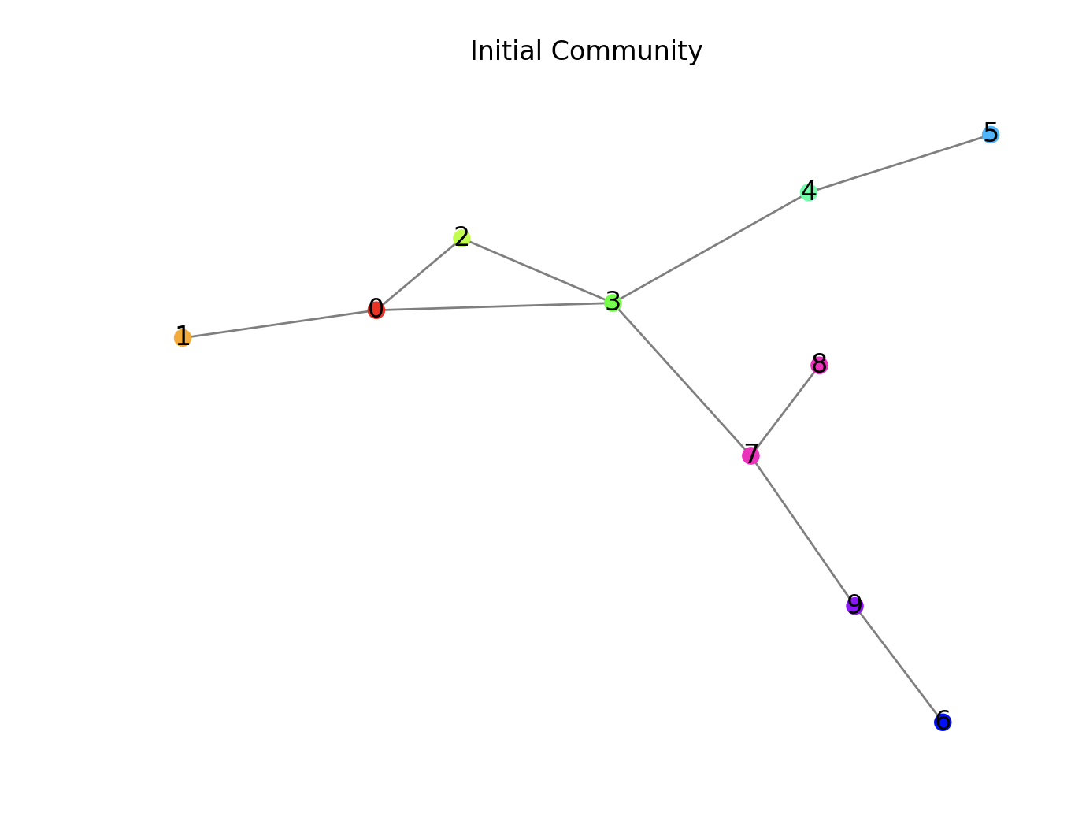
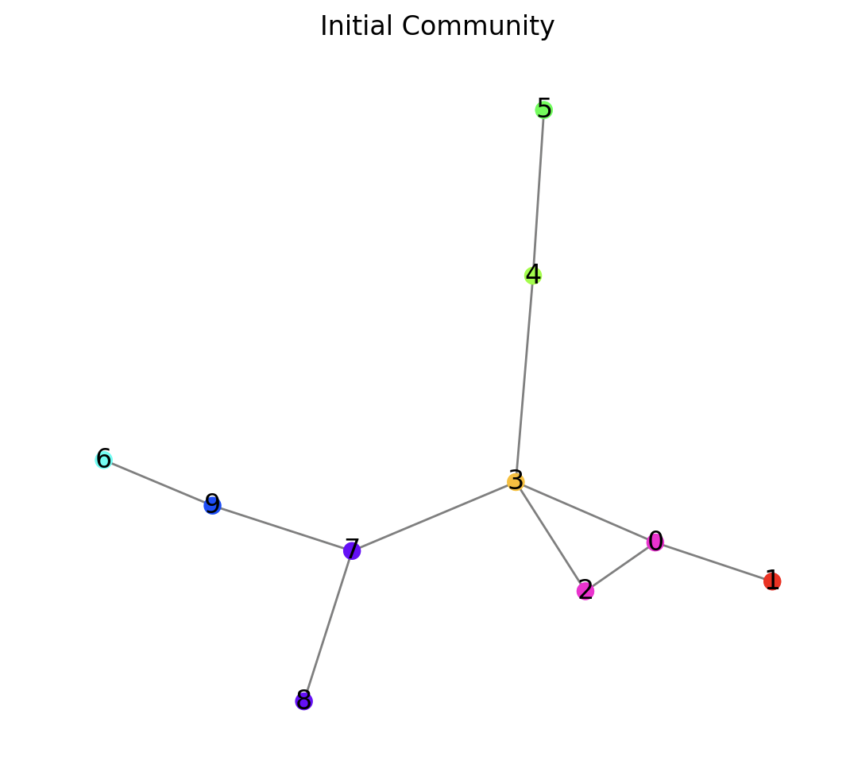
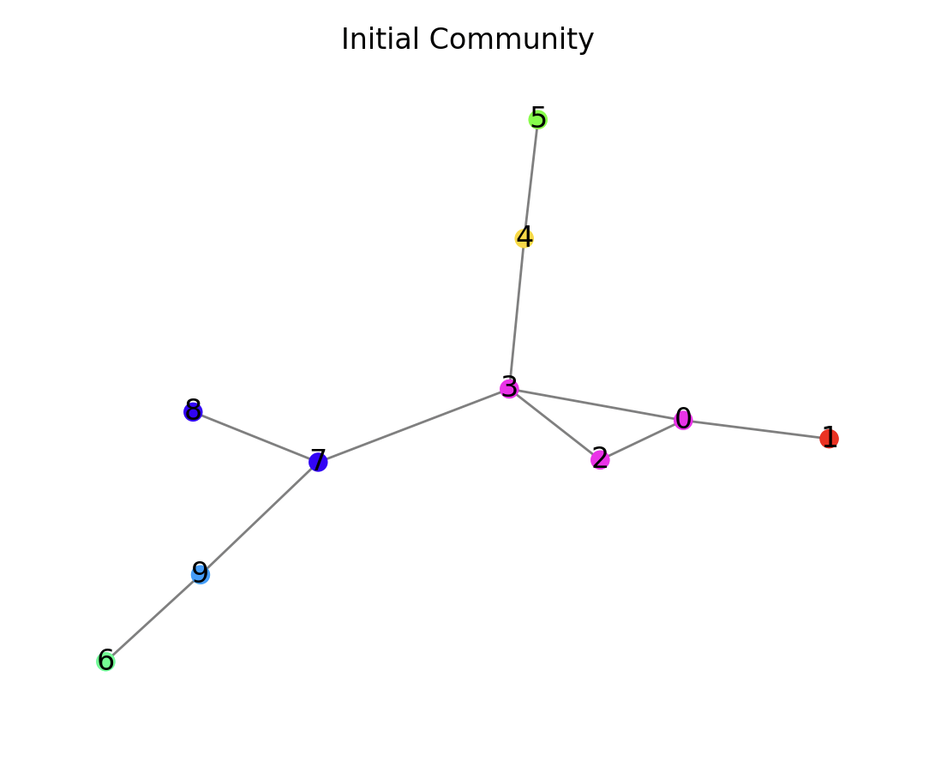
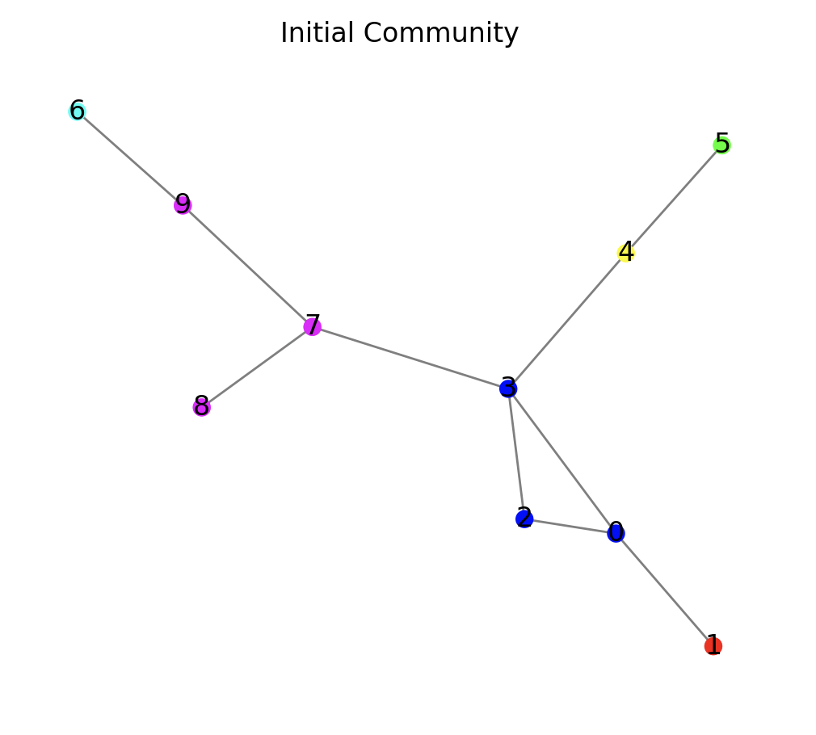
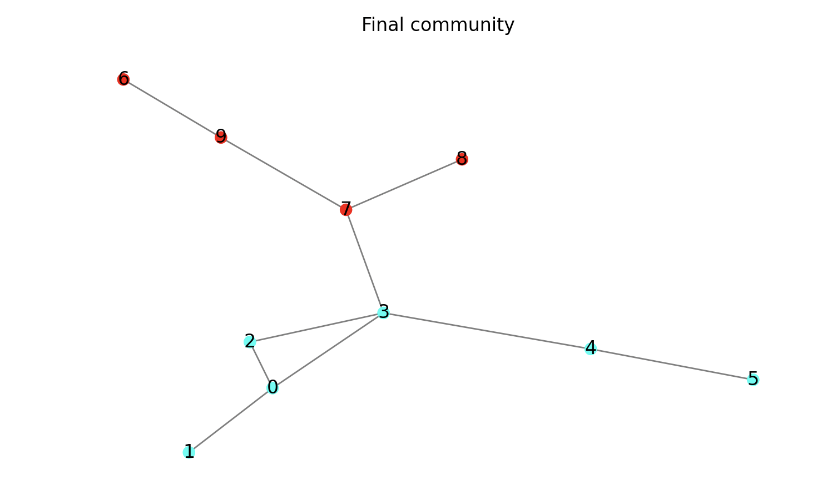
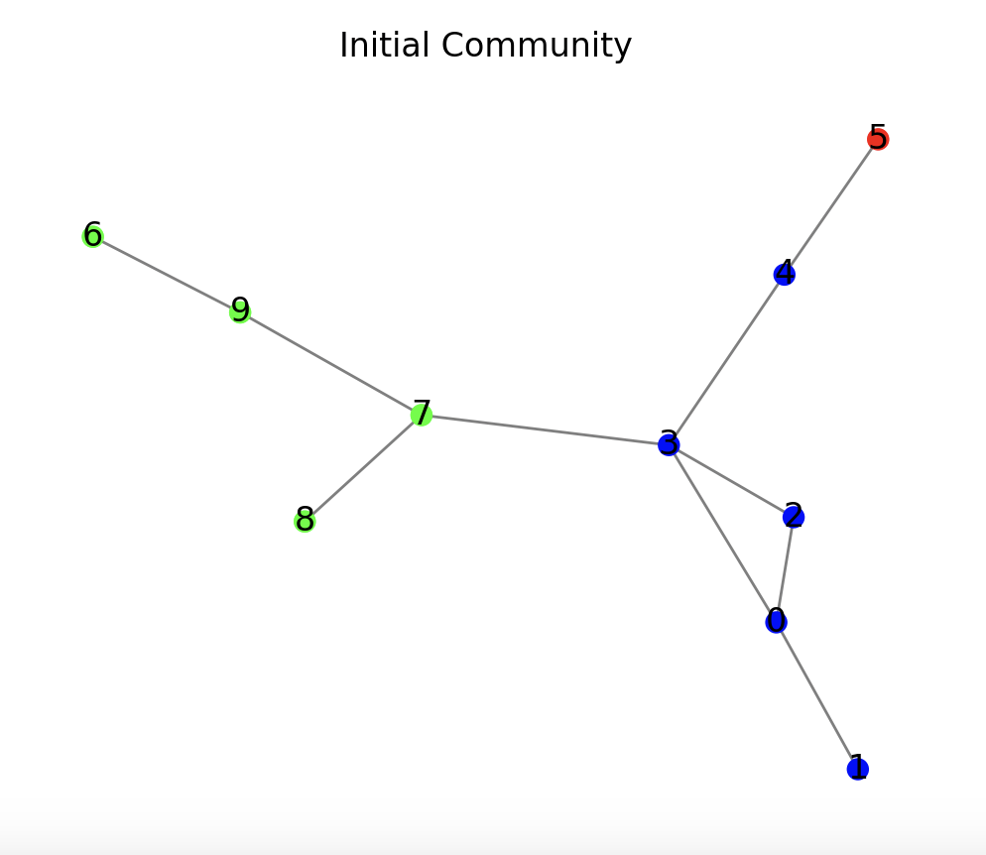
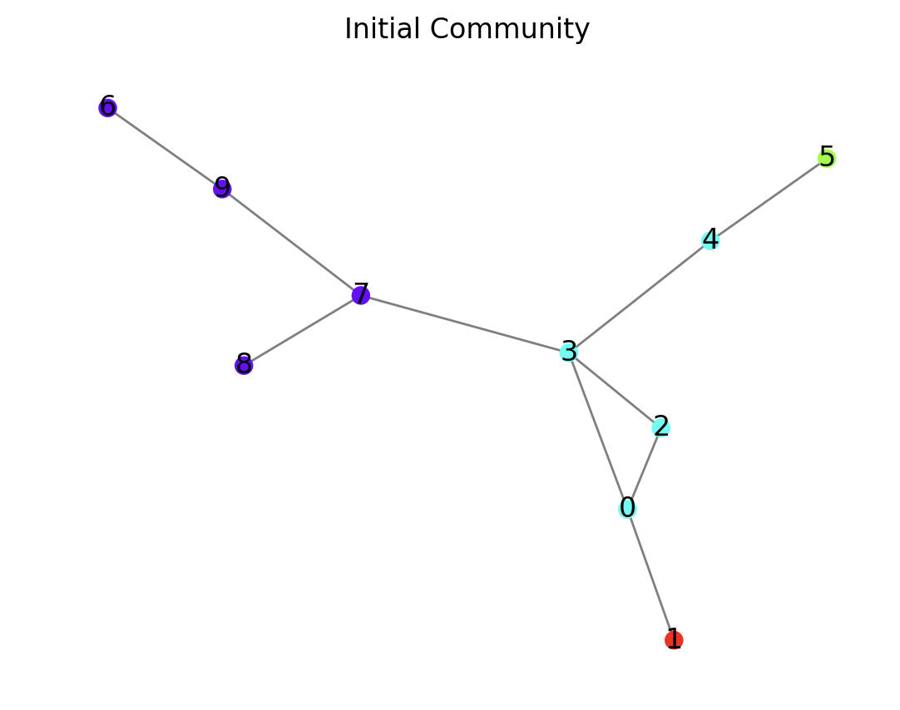
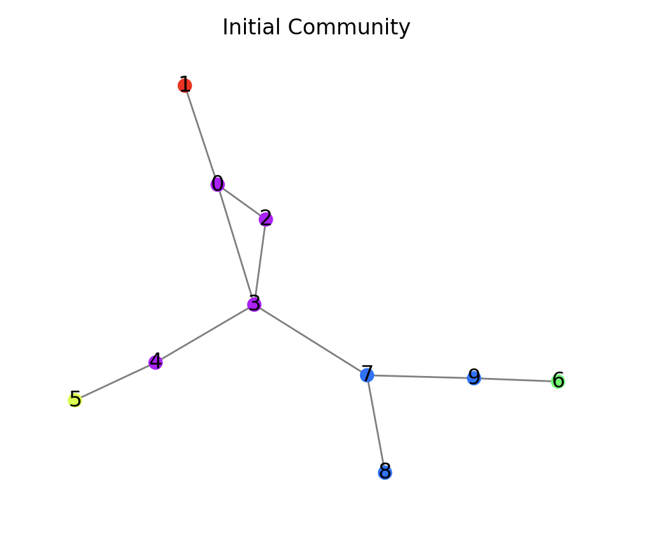
EXAMPLE
→
→
→
→
→
→
→

Slide 11
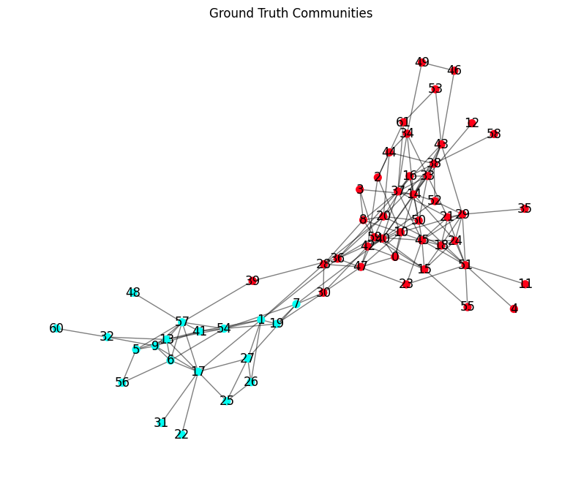
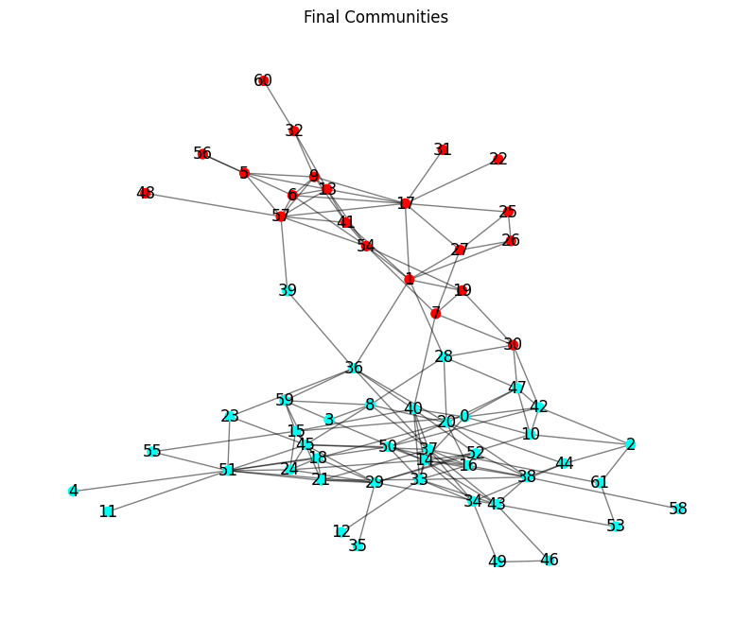
Dolphin
2
2

Slide 12
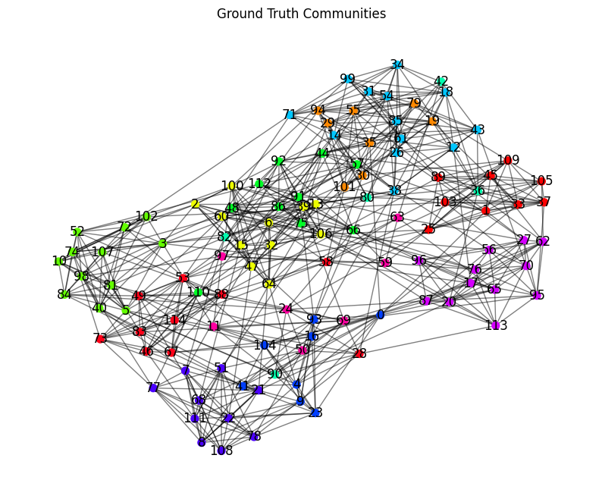
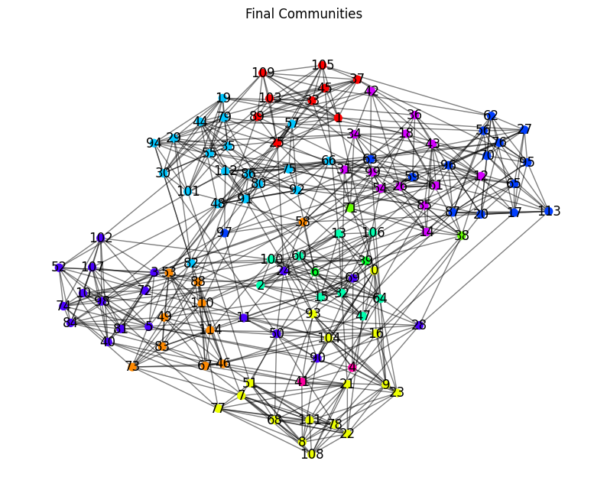
Football
11
11

Slide 13
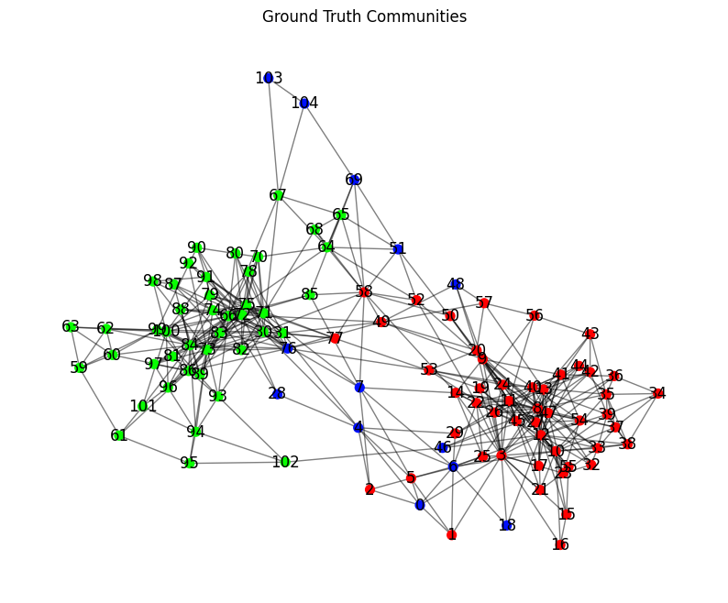
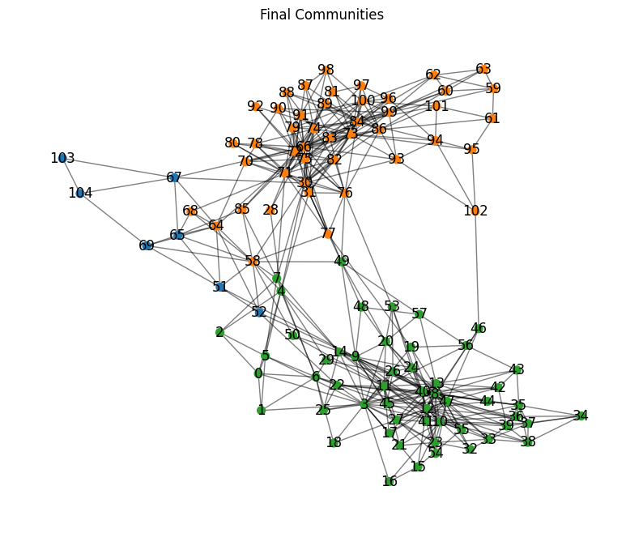
Polbooks
3
3

Slide 14
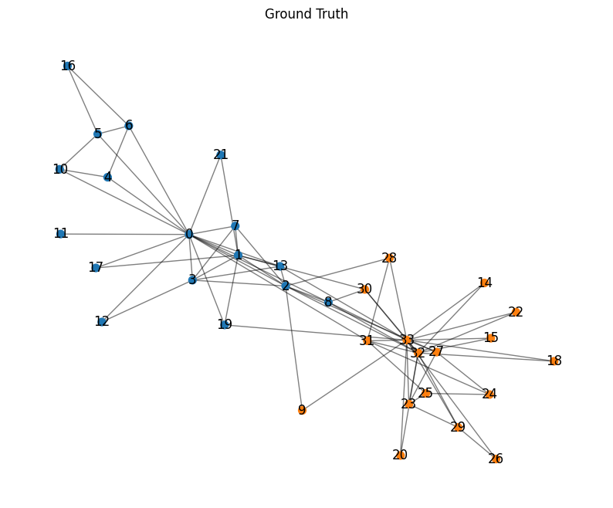
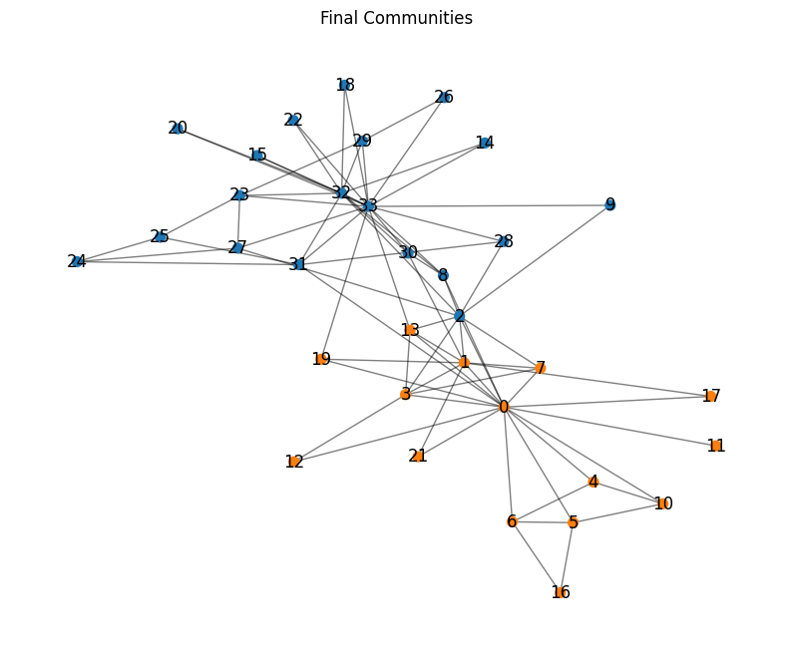
Karate Club
2
2

Slide 15
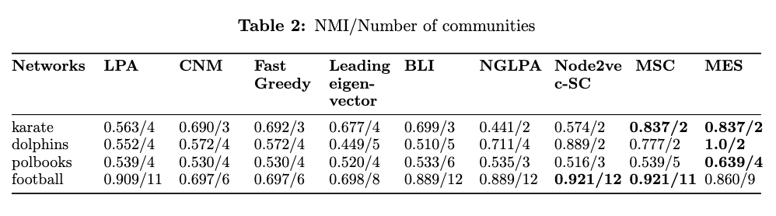
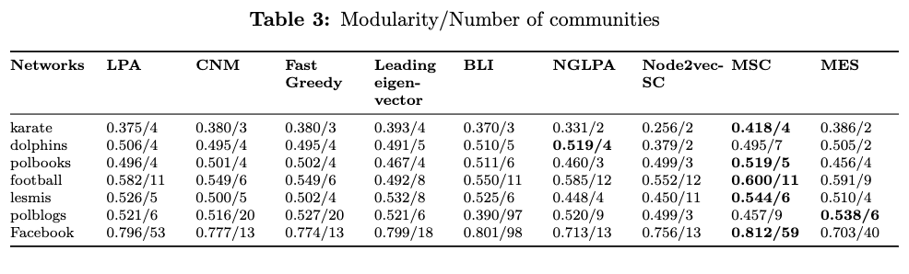
RESULTS

Slide 16
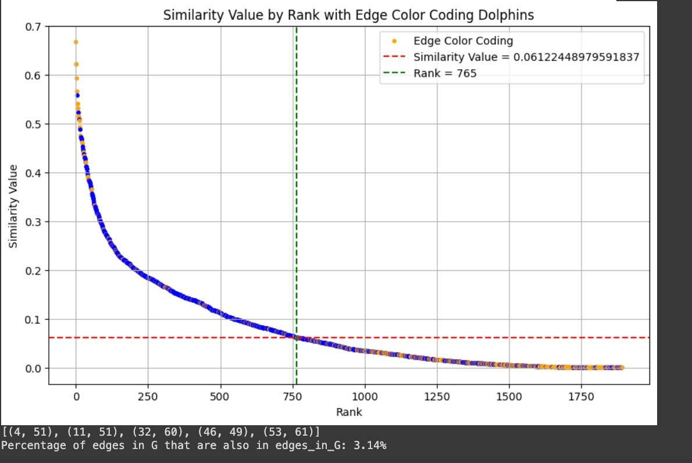
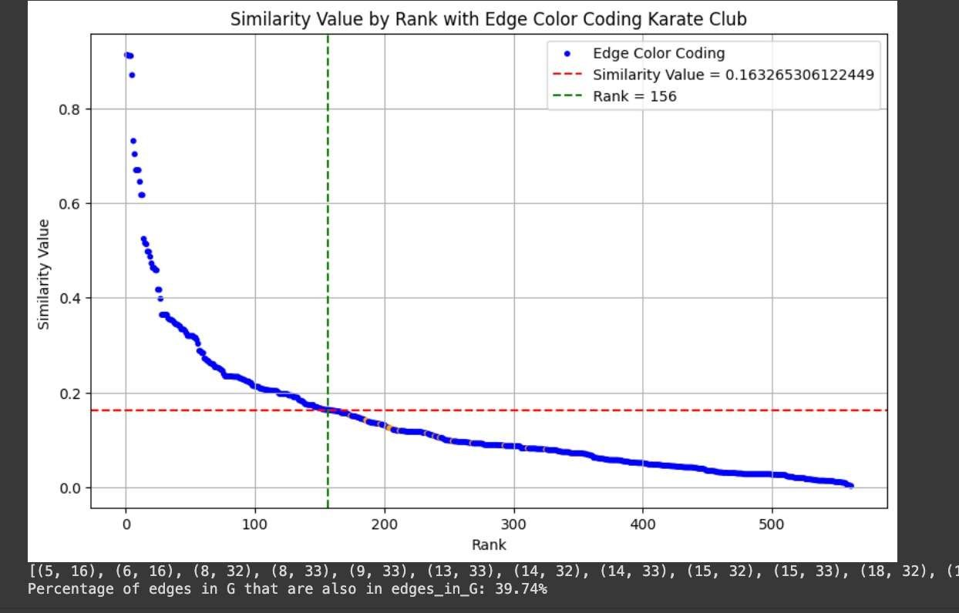
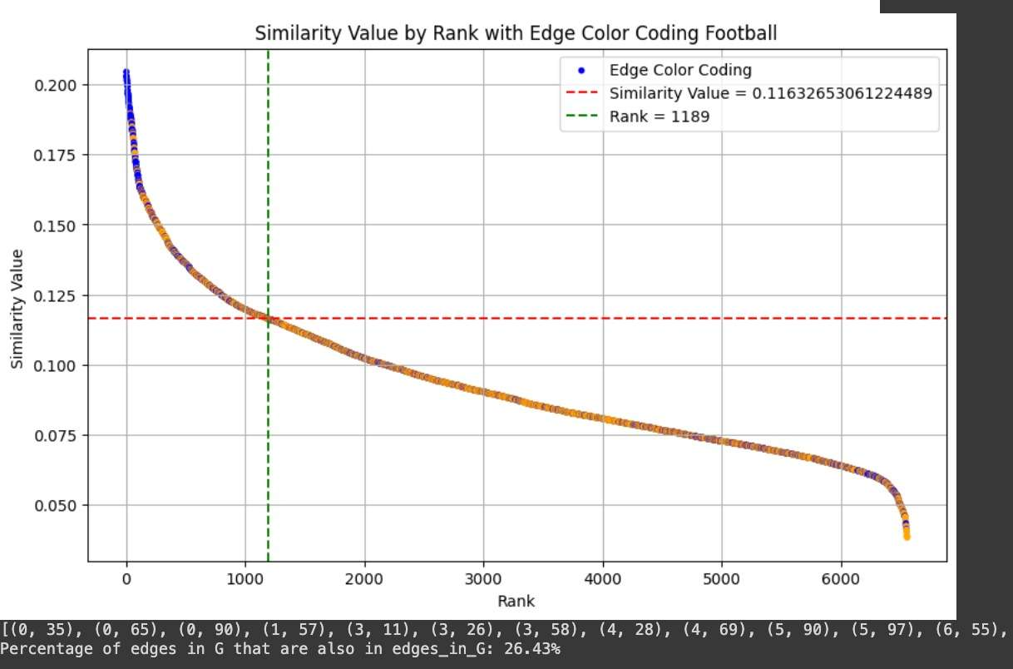
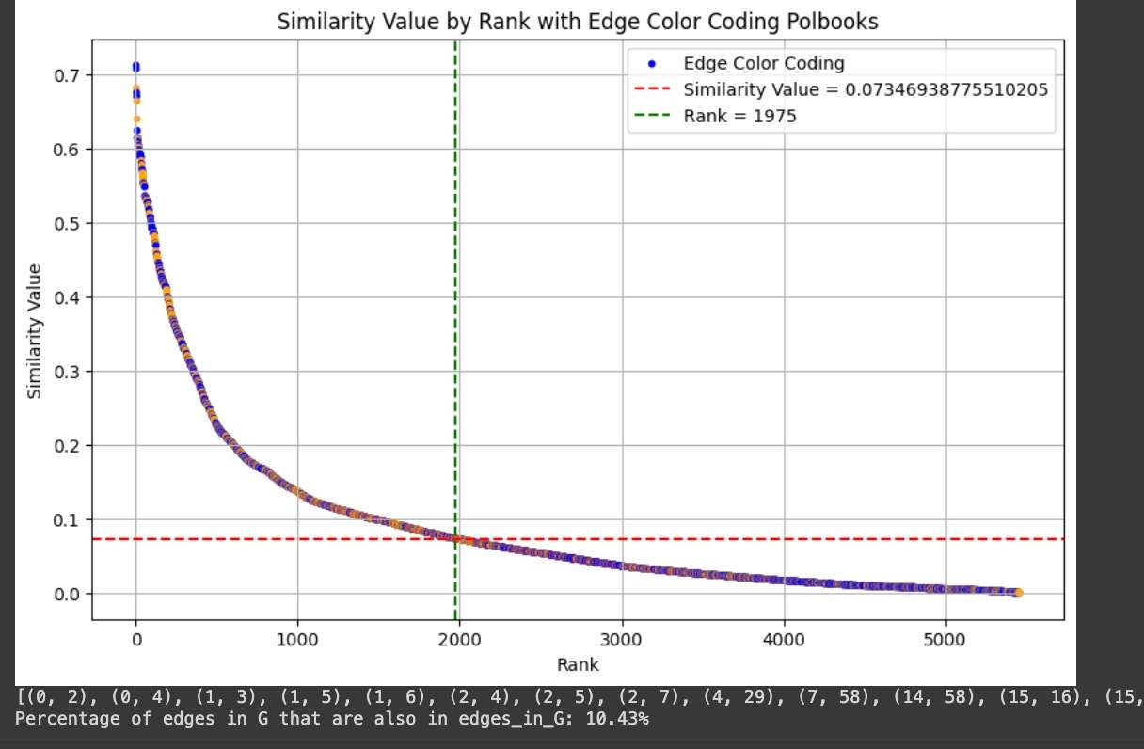
ON GOING WORK ON HEURISTICS

Slide 17
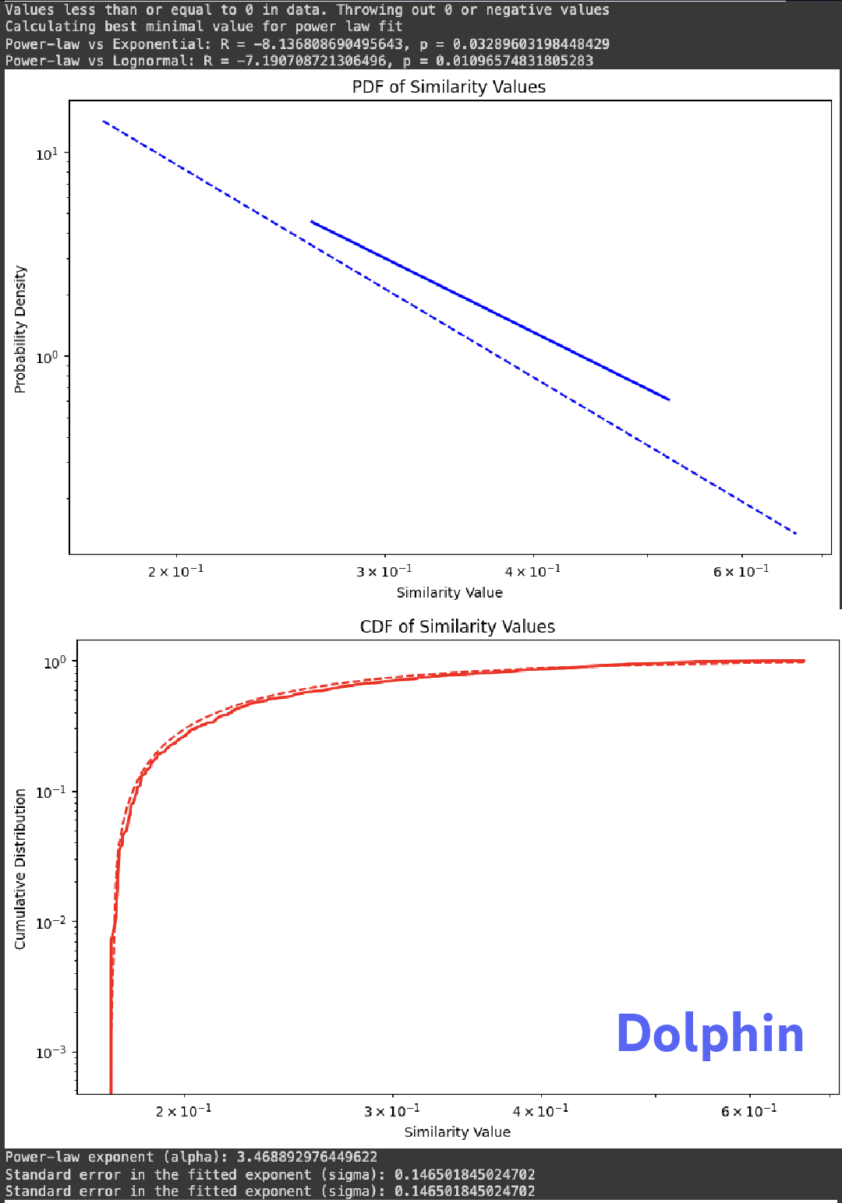
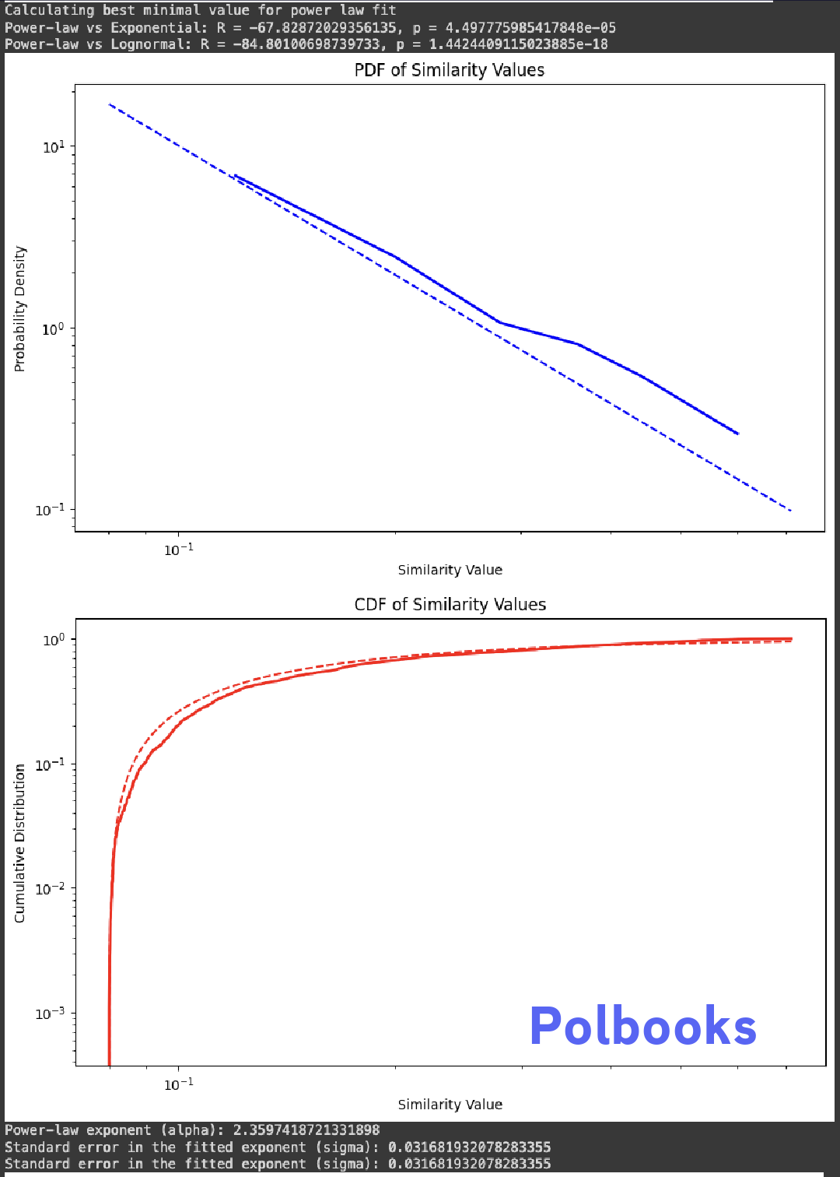
POWER LAW OUTPUTS

Slide 18
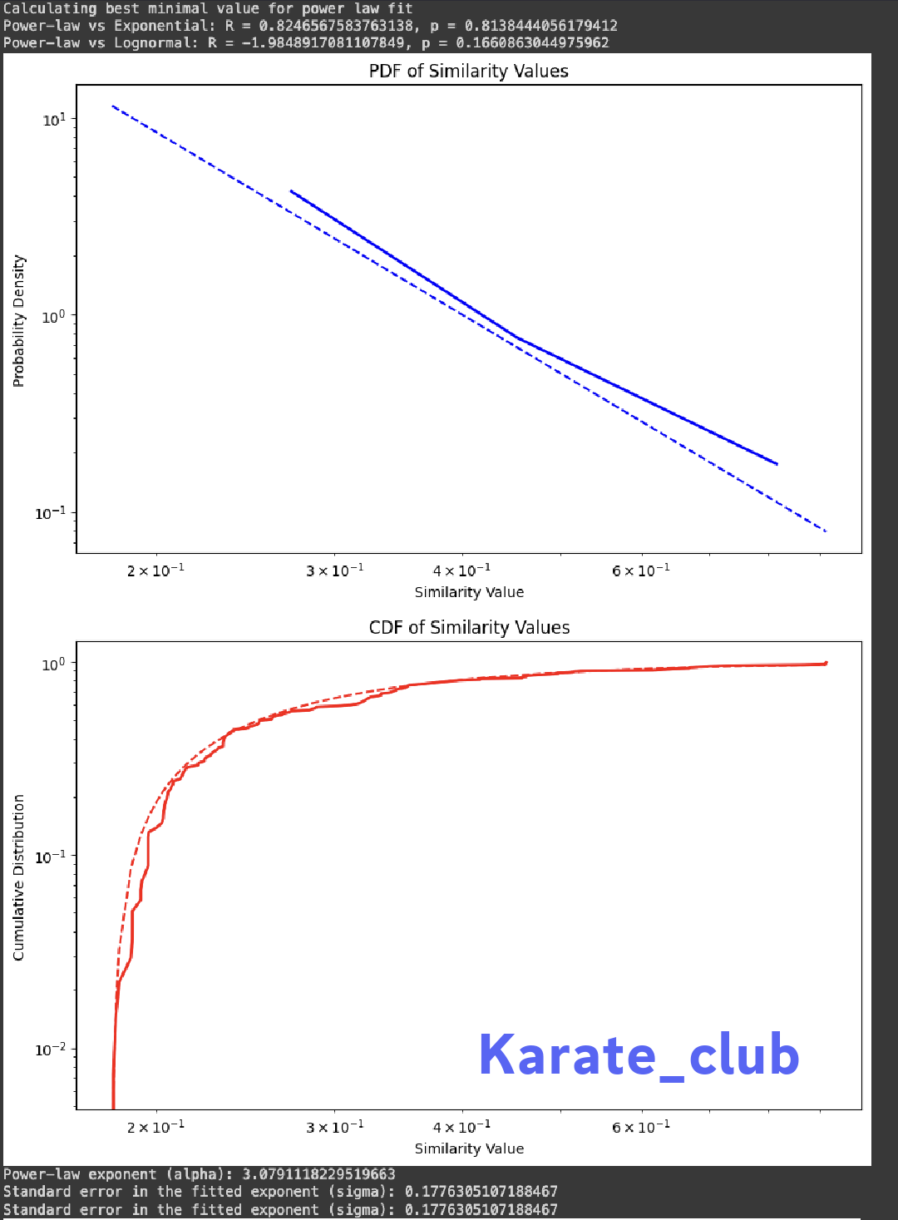
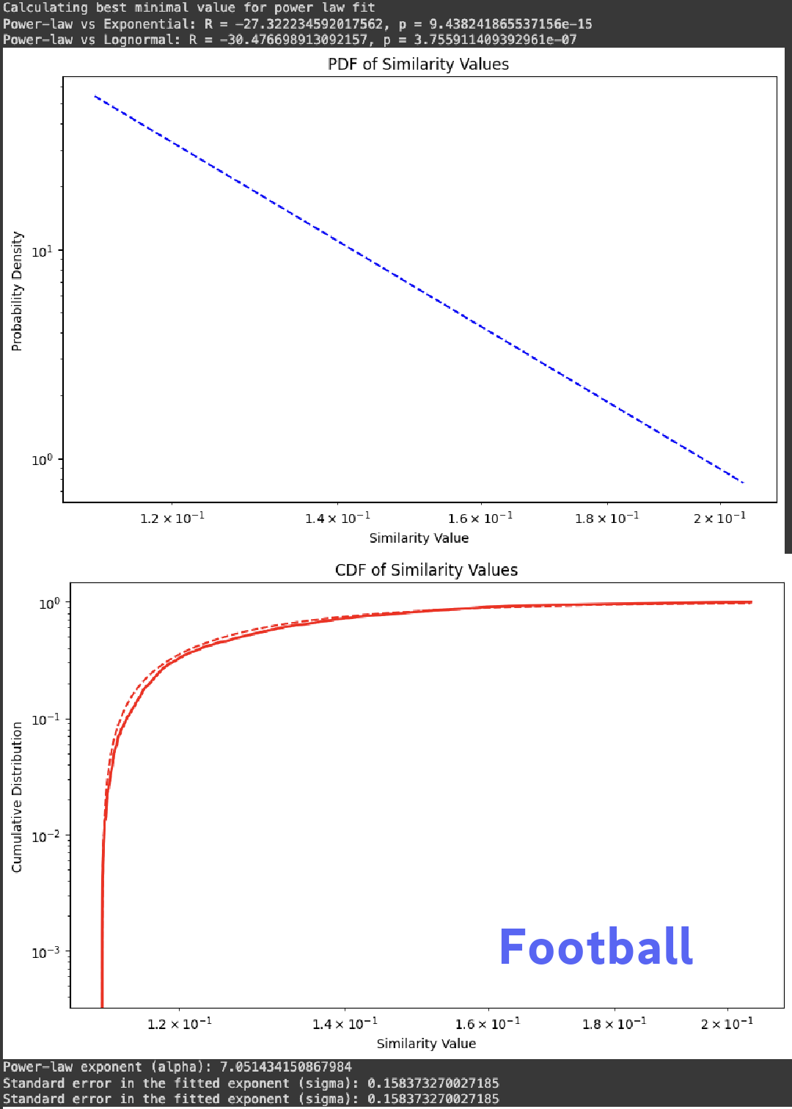
POWER LAW OUTPUTS

Slide 19
FUTURE WORK
In future work, we would like to come up with a good heuristic for defining the similarity threshold.
Further, we want to test our algorithm on artificial networks and modify the algorithm to work on dynamic networks

Slide 20
REFERENCES
Yang, Xu-Hua, Gang-Feng Ma, Xiang-Yu Zeng, Yuchao Pang, Yanbo Zhou, Yu-Di
Zhang & Lei Ye. 2023. Community detection based on markov similarity enhancement.
IEEE Transactions on Circuits and SystemsII: Express Briefs
Blondel, Vincent D, Jean-Loup Guillaume,Renaud Lambiotte & Etienne Lefebvre. 2008.Fast unfolding of communities in large networks. Journal of statistical mechanics: theory and experiment 2008(10). P10008
Rozemberczki, Benedek, Oliver Kiss & Rik Sarkar. 2020. Karate Club: An API Oriented Open-source Python Framework for Unsuperviised Learning on Graphs. En Proceedingsof the 29th ACM International Conference on Information and Knowledge Management
(CIKM ’20), 3125–3132. ACM

Slide 21
THANK YOU

